Slide 1
CIND 820 Predicting default credit card clients
Student: Chandramathi Vitta (501144398)
Professor: Ceni Babagolu

Slide 2
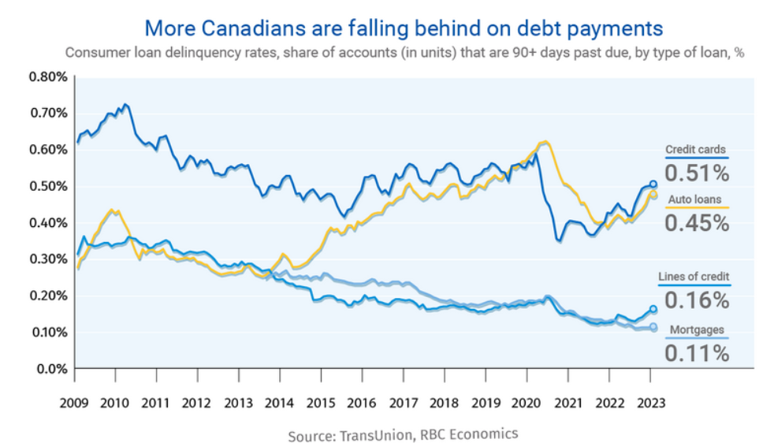
Research background:
External Factors:
Rising costs
Employment
Interest rates
Family situation
Research Motivation:
Improve credit risk prediction by identifying behavior patterns of clients
Recommendations to financial industry to take proactive measures
Notes:
Predicting potential default clients is one of the most challenging problems in the financial industry.
Several external factors can influence clients to go default - rising costs, unemployment, hike in interest rates, family situation
Default is when borrower stops making the payments on a debt. the CC payment is delayed by fewer than 30 days and your account is deliquent. After 80 days it is called “charge-off”. After 180 days of failed payments, issuer closes your account, write off bad debt and sells your account to collections agency.
A bad loan to the bank lead to huge financial loss to banks.
By understanding the factors that contribute to default risks, financial institutions can take proactive measures to mitigate potential risks and ensure the extension of credit to customers with lower default probabilities

Slide 3
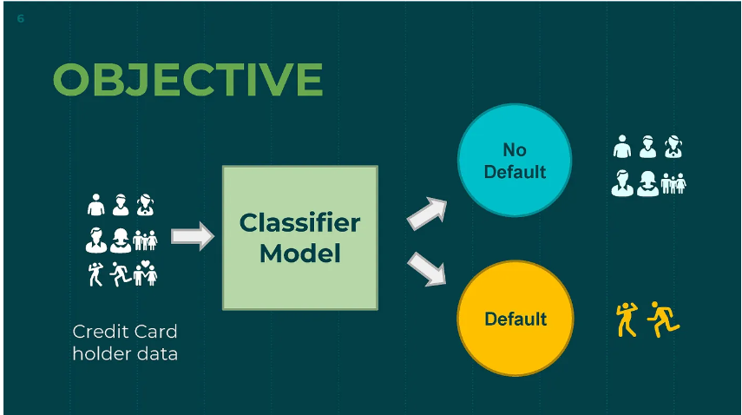
Research Questions
Gain data insights using Exploratory data analysis
Identify key factors using feature selection
Predict default clients using the best classification model
Explore advanced methods to improve accuracy

Slide 4
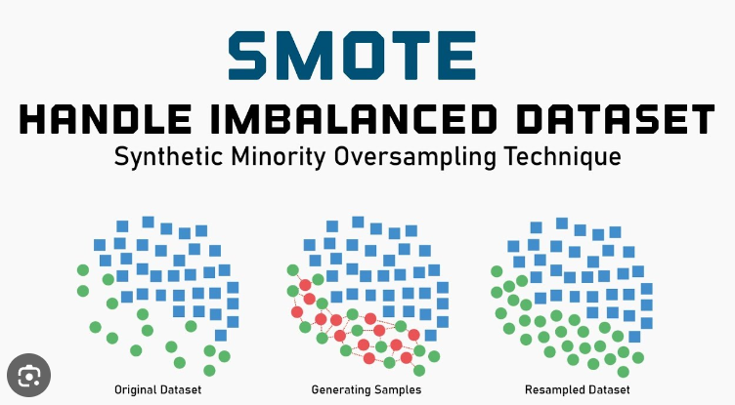
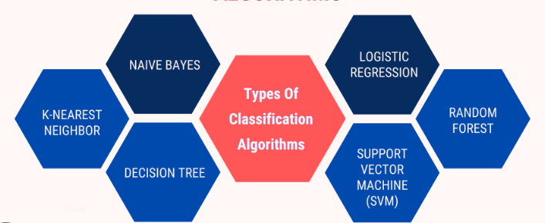
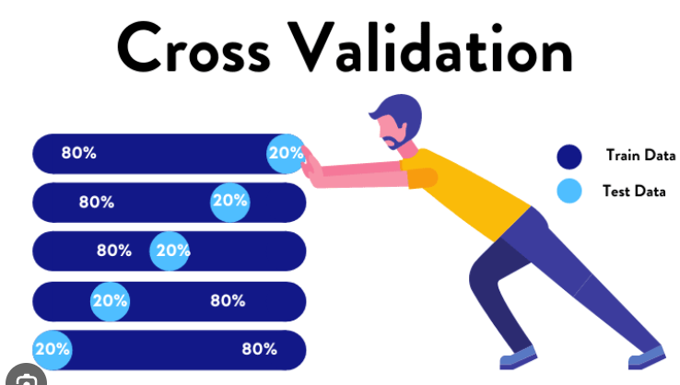
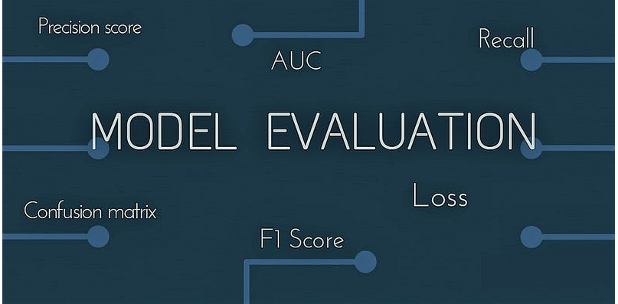
Literature Review – Key Ideas
Notes:
Research paper 1 : 3 datasets from different geographical locations. All are highly imbalanced datasets. Recommends SMOTE (Synthetic Minority Over-sampling Technique).
Research paper 2 : explores diff data mining techniques to predict customer default behavior. Applies logistic regression, decision trees, artificial neural networks, support vector machine (SVM), Xgboost, and LightGBM. ROC-AUC was used to assess the classification performance. Concludes LightGBM is effective among other methods. Importance of 10 fold cross validation in evaluating the performance
Research Paper 3: aims to identify the demographic and socioeconomic characteristics of individuals that contribute to default risk and uses Turkish dataset. Compares six classification algorithms (Naive Bayes, Bayesian networks, J48, random forest, multilayer perceptron, and logistic regression) . Performance is evaluated based on statistical criteria such as root mean error squares, receiver operating characteristic area, accuracy, precision, F-measure, and recall. Logistic regression outperformed in prediction.

Slide 5
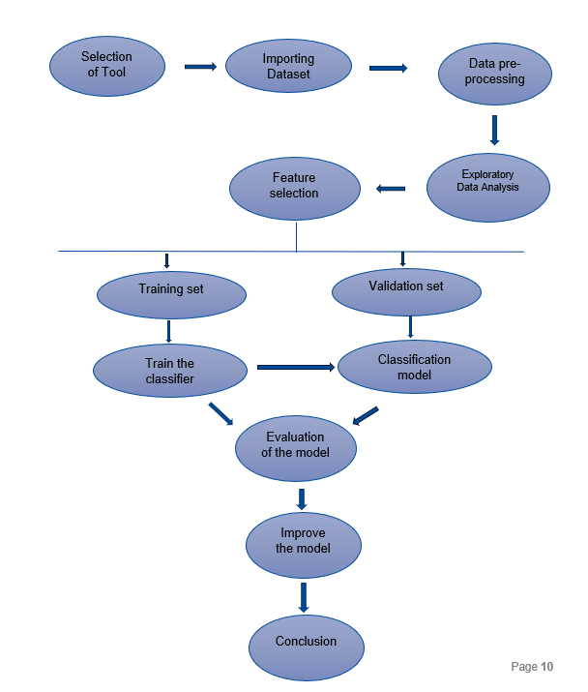
Proposed workflow

Slide 6
Credit card dataset
Source : https://www.kaggle.com/datasets/uciml/default-of-credit-card-clients-dataset (2005).
Credit card clients in Taiwan from April 2005 to September 2005
25 variables and 30000 records
Data Dictionary :
ID: ID of each client
LIMIT_BAL: Amount of given credit in NT dollars (includes individual and family/supplementary credit)
SEX: Gender (1=male, 2=female)
EDUCATION: (1=graduate school, 2=university, 3=high school, 4=others)
MARRIAGE: Marital status (1=married, 2=single, 3=others)
AGE: Age in years
PAY_0 to PAY_6 (6 features): Repayment status (-1=pay duly, 1=payment delay for one month, 2=payment delay for two months, … 8=payment delay for eight months, 9=payment delay for nine months and above)
BILL_AMT1 to BILL_AMT6(6 features) : Amount of bill statement
PAY_AMT1 to PAY_AMT6(6 features): Amount of previous payment
default.payment.next.month: Default payment (1=yes, 0=no)

Slide 7
Data Preprocessing:
Convert categorical data (Sex, Education, Marriage, Pay_n attributes) to categorical data type.
Drop attributes of no value – drop first attribute "ID".
Grouping of undefined categories into unknown category.
Education attribute - grouping 0, 5 and 6 categories to one group ie., unknown (4)
Marriage attribute - grouping 0 category to unknown (3)
Rename "default.payment.next.month" attribute as ‘default, and "PAY_0" attribute as “PAY_1”
Repayment Status (PAY_X) : convert -2,-1 values to -1.

Slide 8
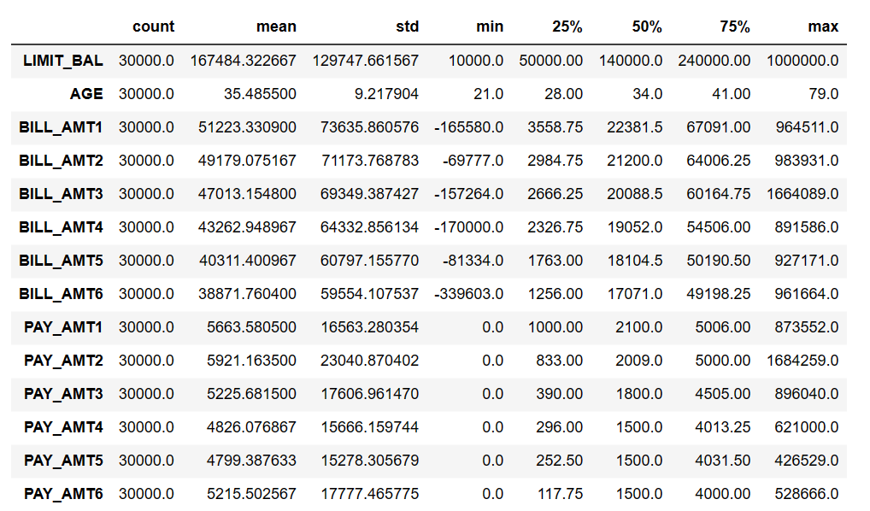
5 number summary - Numerical Attributes
Notes:
Except Age all numerical attributes has high value of STD and are right skewed. because most of the defaults are of credit limit 0 – 10,00,000
Dataset has several outliers, but since removing them would cost valuable loss of information. Hence outliers will not be treated

Slide 9
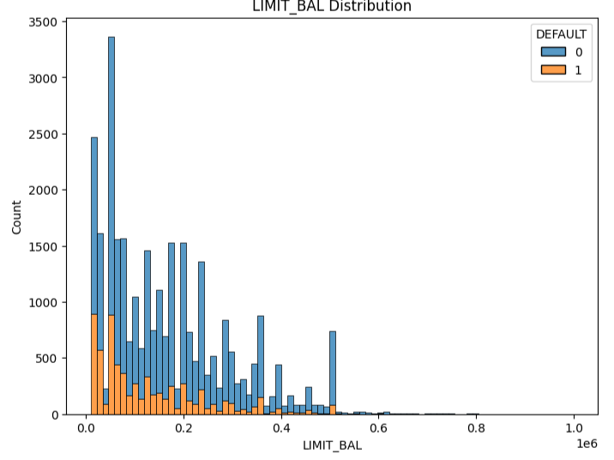
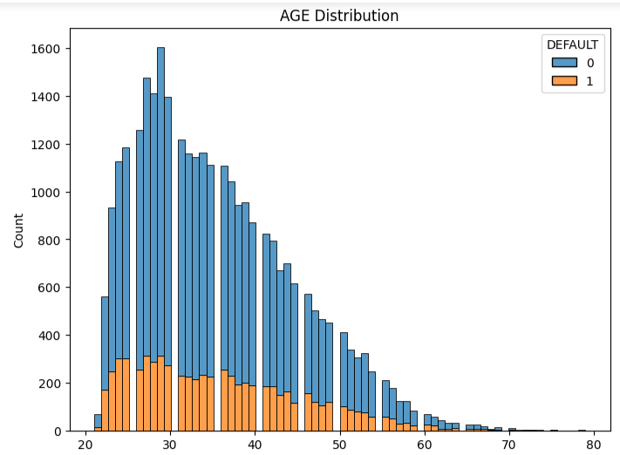
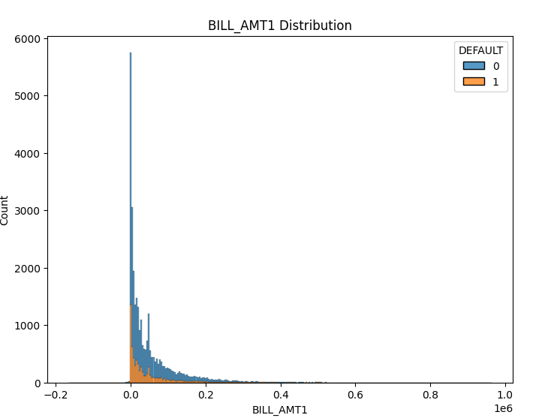
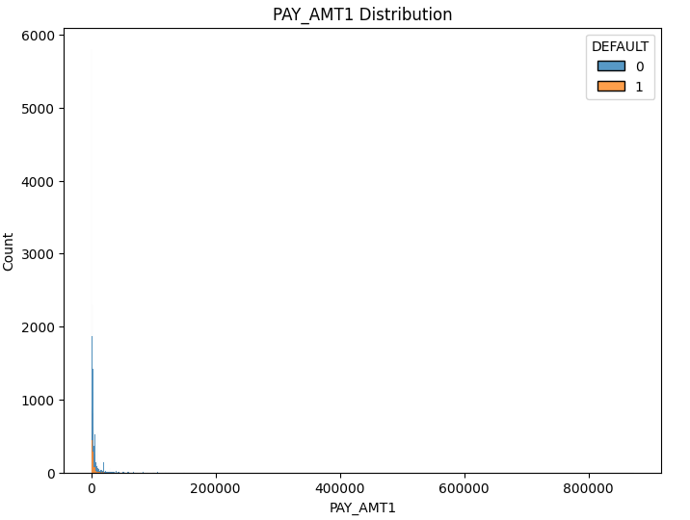
Data Visualization – Numerical attributes

Slide 10
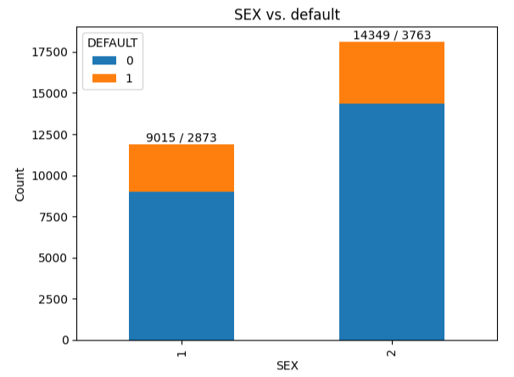
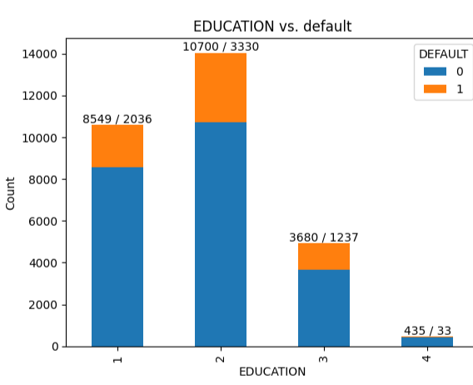
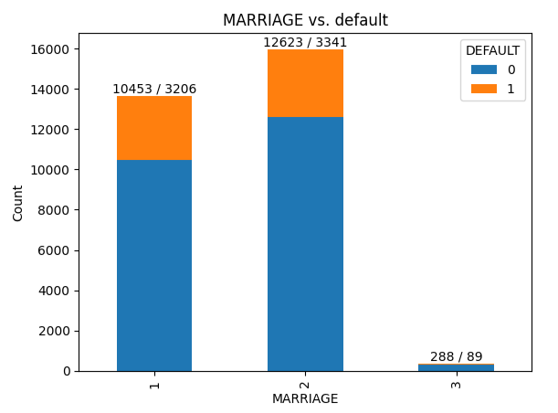
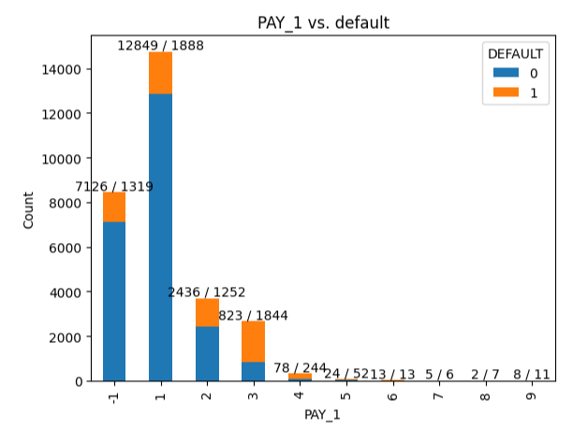
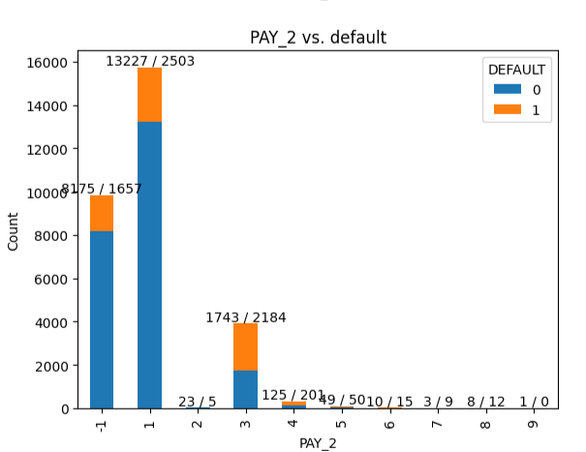
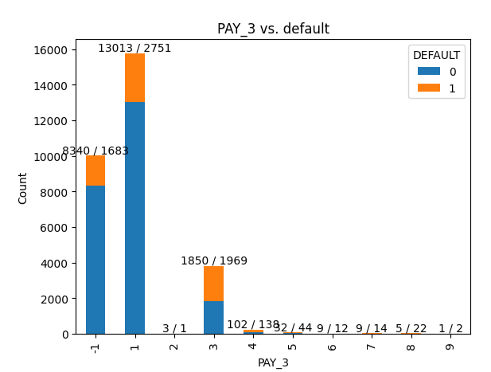
Data Visualization – Categorical attributes
Notes:
SEX: Gender (1=male, 2=female) : Female consumers are more commonly using CC than male consumers and have more chances to default.
EDUCATION: (1=graduate school, 2=university, 3=high school, 4=others) University and high school students have more chances to default.
MARRIAGE: Marital status (1=married, 2=single, 3=others) Unmarried persons have more chances to default.
PAY 1..6: Having a delay, even for 1 month in any of the previous months, increases the chance of default.

Slide 11
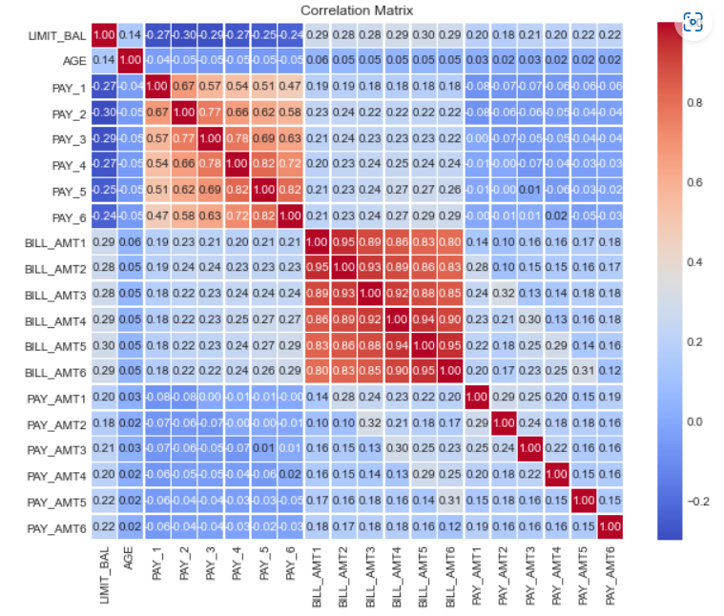
Correlation
Notes:
We see a high level of linear correlations between the amounts of bill statements in different months. Age, LIMIT_BAL and PAY_AMT are less correlated.

Slide 12
Data Pre-processing contd..
One-hot encoding on categorical variables with ordinal values (Sex, Marriage, Education and PAY_1 to PAY_6)
Standardization on numerical attributes using StandardScalar() method
Feature selection using ExtraTreesClassifier() method to select top 5 features to feed the machine learning algorithm
1. feature 67 - AGE (0.065810) 2. feature 66 - LIMIT_BAL (0.063352) 3. feature 68 - BILL_AMT1 (0.052328) 4. feature 11 - PAY_1_0.4 (0.050232) 5. feature 69 - BILL_AMT2 (0.048430)

Slide 13
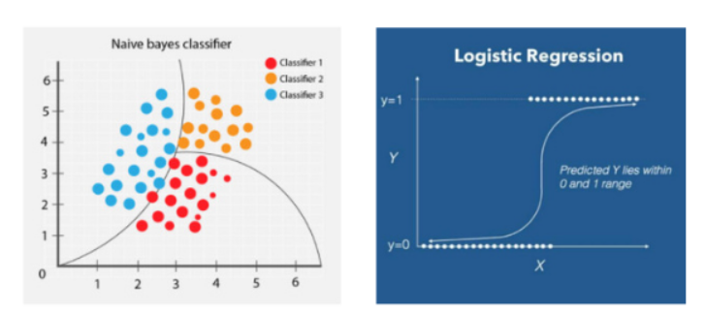
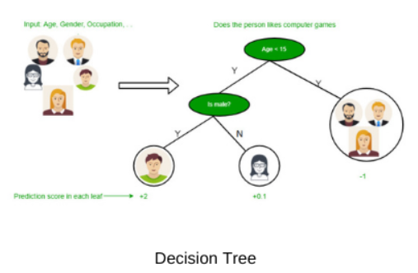
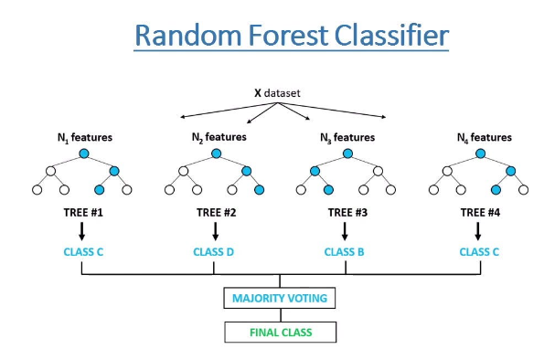
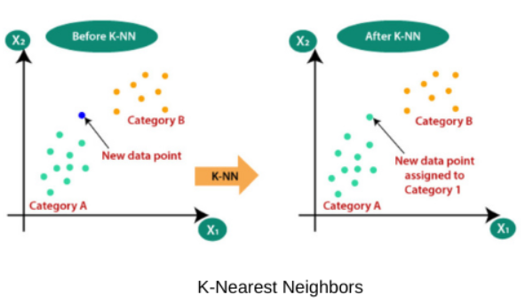
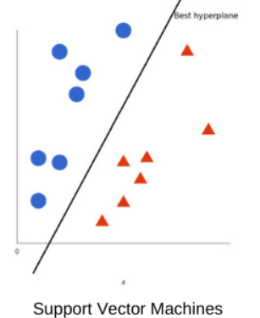
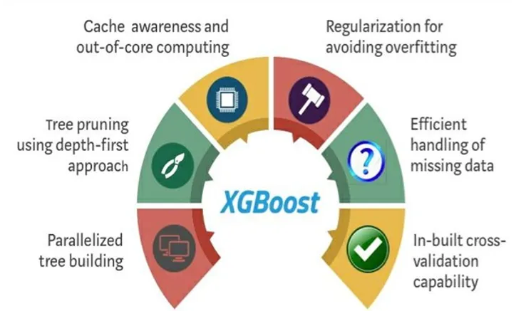
Classification models :
Notes:
6 classification models were applied on the dataset

Slide 14
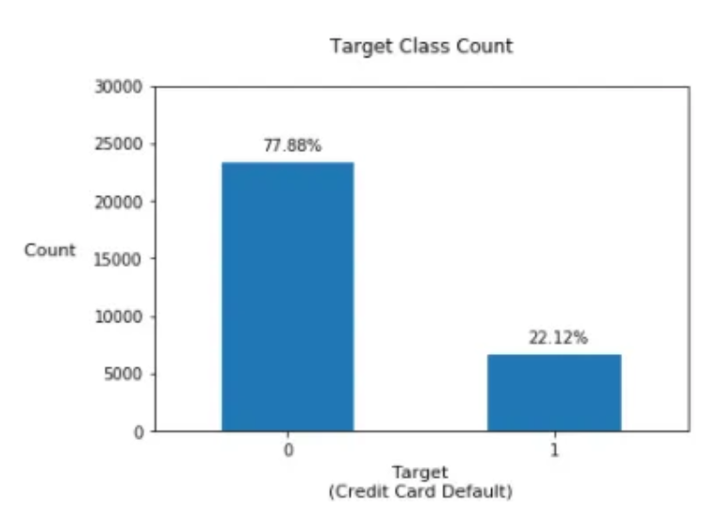
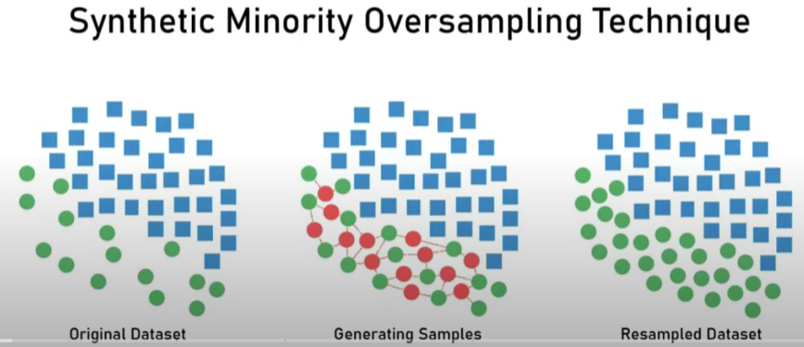
Handling Imbalanced Dataset
Notes:
We can see that the dataset is imbalanced consisting of 77% clients are not expected to default payment whereas 23% clients are expected to default the payment.

Slide 15
Evaluation method & Metrics
5-fold cross-validation for each model before applying K-smote
Algorithm | Accuracy |  | Precision |  | Recall |  | F1 Score |  | AUC
 | Train Set | Test Set | Train Set | Test Set | Train Set | Test Set | Train Set | Test Set
Decision Tree | 0.99 | 0.71 | 0.99 | 0.35 | 0.97 | 0.36 | 0.98 | 0.36 | 0.6
Logistic Regression | 0.81 | 0.8 | 0.69 | 0.66 | 0.27 | 0.27 | 0.39 | 0.38 | 0.69
Random Forest | 0.99 | 0.79 | 0.98 | 0.56 | 0.97 | 0.3 | 0.98 | 0.39 | 0.69
XGBClassifer | 0.83 | 0.8 | 0.81 | 0.65 | 0.34 | 0.27 | 0.48 | 0.38 | 0.72
SVCClassifier | 0.81 | 0.8 | 0.69 | 0.66 | 0.27 | 0.27 | 0.39 | 0.38 | 0.62
KNNClassifier | 0.83 | 0.77 | 0.71 | 0.49 | 0.41 | 0.3 | 0.52 | 0.37 | 0.65
5-fold cross-validation for each model after applying K-smote
Algorithm | Accuracy |  | Precision |  | Recall |  | F1 Score |  | AUC
 | Train Set | Test Set | Train Set | Test Set | Train Set | Test Set | Train Set | Test Set
Decision Tree | 0.99 | 0.81 | 0.99 | 0.8 | 0.99 | 0.81 | 0.99 | 0.8 | 0.81
Logistic Regression | 0.88 | 0.87 | 0.95 | 0.95 | 0.79 | 0.78 | 0.87 | 0.86 | 0.9
Random Forest | 0.99 | 0.87 | 0.99 | 0.92 | 0.99 | 0.8 | 0.99 | 0.85 | 0.91
XGBClassifer | 0.89 | 0.87 | 0.96 | 0.95 | 0.81 | 0.78 | 0.88 | 0.86 | 0.91
SVCClassifier | 0.88 | 0.87 | 0.95 | 0.95 | 0.79 | 0.78 | 0.87 | 0.86 | 0.88
KNNClassifier | 0.89 | 0.85 | 0.93 | 0.89 | 0.84 | 0.8 | 0.88 | 0.84 | 0.9
Notes:
Initial model predictions did not achieve high accuracy and AUC-ROC scores. To address this, the K-means SMOTE algorithm was applied, resulting in a significant improvement in prediction performance with an accuracy of 0.92. Among the classifiers tested, the XGBoost classifier emerged as a high-performance model with accurate and precise predictions.

Slide 16
Research Summary:
In this research paper, various classification techniques were proposed for predicting default credit card clients, and their results were evaluated using k-fold cross-validation methods.
The initial model predictions did not achieve high accuracy and AUC-ROC scores(0.72 for XGB Classifier being the highest).
To address this, the K-means SMOTE algorithm was applied, resulting in a significant improvement in prediction performance with an AUC-ROC scores of 0.91. Among the classifiers tested, the XGBoost classifier emerged as a high-performance model with high accuracy and precision scores

Slide 17
Limitations & Future work
Limitations:
Biased dataset
Limited demographic and geographic regions
Lack certain features that contribute to default
Testing with more alternative samples
Imbalance dataset may lead to biased predictions
Future Work:
Explore advance methods to balance the dataset and enhance performance
Hyper parameter tuning using XG Boost to increase accuracy
Investigate other factors that influence default behavior using variety of dataset

Slide 18
Thank you for listening

